Slide 1
RISC ARCHITECTURE:
RISC (Reduced Instruction Set Computer) is used in portable devices due to its power efficiency. For Example, Apple iPod and Nintendo DS.
RISC is a type of microprocessor architecture that uses highly-optimized set of instructions. RISC does the opposite, reducing the cycles per instruction at the cost of the number of instructions per program Pipelining is one of the unique feature of RISC.
It is performed by overlapping the execution of several instructions in a pipeline fashion. It has a high performance advantage over CISC.

Slide 2
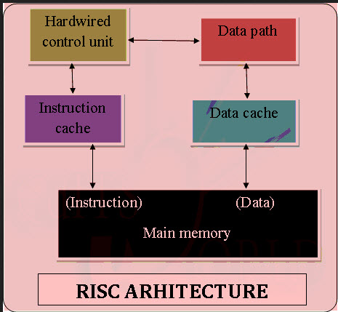
RISC ARCHITECTURE:

Slide 3
RISC ARCHITECTURE CHARACTERISTICS
Simple Instructions are used in RISC architecture.
RISC helps and supports few simple data types and synthesize complex data types.
RISC utilizes simple addressing modes and fixed length instructions for pipelining.
RISC permits any register to use in any context.
One Cycle Execution Time
The amount of work that a computer can perform is reduced by separating “LOAD” and “STORE” instructions.
RISC contains Large Number of Registers in order to prevent various number of interactions with memory.

Slide 4
RISC ARCHITECTURE CHARACTERISTICS
In RISC, Pipelining is easy as the execution of all instructions will be done in a uniform interval of time i.e. one click.
In RISC, more RAM is required to store assembly level instructions.
Reduced instructions need a less number of transistors in RISC.
RISC uses Harvard memory model means it is Harvard Architecture.
A compiler is used to perform the conversion operation means to convert a high-level language statement into the code of its form.

Slide 5
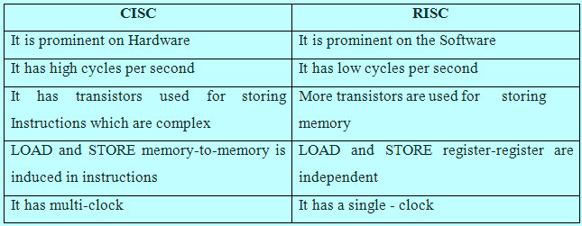
RISC & CISC COMPARISON

Slide 6
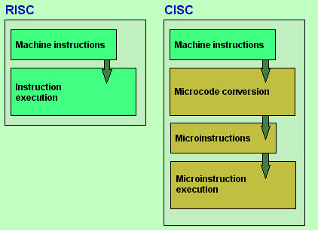
MUL instruction is divided into three instructions “LOAD” – moves data from the memory bank to a register “PROD” – finds product of two operands located within the registers “STORE” – moves data from a register to the memory banks The main difference between RISC and CISC is the number of instructions and its complexity.

Slide 7
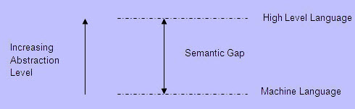
SEMANTIC GAP:
Both RISC and CISC architectures have been developed as an attempt to cover the semantic gap.
Semantic Gap

Slide 8
SEMANTIC GAP:
With an objective of improving efficiency of software development, several powerful programming languages have come up, viz., Ada, C, C++, Java, etc.
They provide a high level of abstraction, conciseness and power. By this evolution the semantic gap grows. To enable efficient compilation of high level language programs, CISC and RISC designs are the two options.
The features of RISC include the following
The demand of decoding is less
Uniform instruction set
Few data types in hardware
General purpose register Identical
Simple addressing nodes

Slide 9
ADVANTAGES OF RISC ARCHITECTURE:
RISC(Reduced instruction set computing)architecture has a set of instructions, so high-level language compilers can produce more efficient code
It allows freedom of using the space on microprocessors because of its simplicity.
Many RISC processors use the registers for passing arguments and holding the local variables.
RISC functions use only a few parameters, and the RISC processors cannot use the call instructions, and therefore, use a fixed length instruction which is easy to pipeline.
The speed of the operation can be maximized and the execution time can be minimized. Very less number of instructional formats, a few numbers of instructions and a few addressing modes are needed.

Slide 10
DISADVANTAGES OF RISC ARCHITECTURE:
Mostly, the performance of the RISC processors depends on the programmer or compiler as the knowledge of the compiler plays a vital role while changing the CISC code to a RISC code
While rearranging the CISC code to a RISC code, termed as a code expansion, will increase the size. And, the quality of this code expansion will again depend on the compiler, and also on the machine’s instruction set.
The first level cache of the RISC processors is also a disadvantage of the RISC, in which these processors have large memory caches on the chip itself. For feeding the instructions, they require very fast memory systems.

Slide 11
CISC ARCHITECTURE
The CISC approach attempts to minimize the number of instructions per program, sacrificing the number of cycles per instruction. Computers based on the CISC architecture are designed to decrease the memory cost.
Because, the large programs need more storage, thus increasing the memory cost and large memory becomes more expensive.
To solve these problems, the number of instructions per program can be reduced by embedding the number of operations in a single instruction, thereby making the instructions more complex.

Slide 12
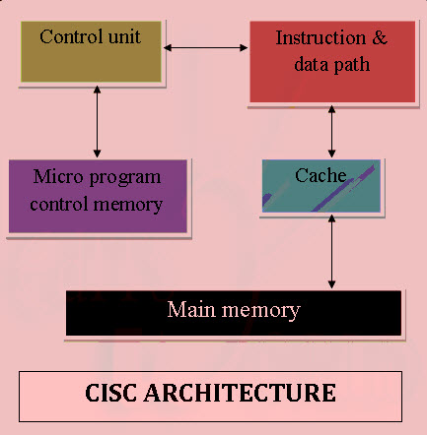
CISC ARCHITECTURE
MUL loads two values from the memory into separate registers in CISC.
CISC uses minimum possible instructions by implementing hardware and executes operations.
Instruction Set Architecture is a medium to permit communication between the programmer and the hardware. Data execution part, copying of data, deleting or editing is the user commands used in the microprocessor and with this microprocessor the Instruction set architecture is operated.

Slide 13
CISC ARCHITECTURE
The main keywords used in the above Instruction Set Architecture are as below
Instruction Set: Group of instructions given to execute the program and they direct the computer by manipulating the data. Instructions are in the form – Opcode (operational code) and Operand. Where, opcode is the instruction applied to load and store data, etc. The operand is a memory register where instruction applied.
Addressing Modes: Addressing modes are the manner in the data is accessed. Depending upon the type of instruction applied, addressing modes are of various types such as direct mode where straight data is accessed or indirect mode where the location of the data is accessed. Processors having identical ISA may be very different in organization. Processors with identical ISA and nearly identical organization is still not nearly identical.

Slide 14

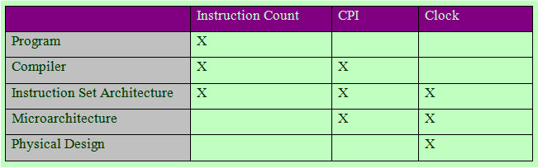
CISC ARCHITECTURE
CPU performance is given by the fundamental law
Thus, CPU performance is dependent upon Instruction Count, CPI (Cycles per instruction) and Clock cycle time. And all three are affected by the instruction set architecture.
Instruction Count of the CPU

Slide 15
CISC ARCHITECTURE
Examples of CISC PROCESSORS
IBM 370/168 – It was introduced in the year 1970. CISC design is a 32 bit processor and four 64-bit floating point registers. VAX 11/780 – CISC design is a 32-bit processor and it supports many numbers of addressing modes and machine instructions which is from Digital Equipment Corporation. Intel 80486 – It was launched in the year 1989 and it is a CISC processor, which has instructions varying lengths from 1 to 11 and it will have 235 instructions.
CHARACTERISTICS OF CISC ARCHITECTURE
Instruction-decoding logic will be Complex.
One instruction is required to support multiple addressing modes.
Less chip space is enough for general purpose registers for the instructions that are 0operated directly on memory.
Various CISC designs are set up two special registers for the stack pointer, handling interrupts, etc.
MUL is referred to as a “complex instruction” and requires the programmer for storing functions.

Slide 16
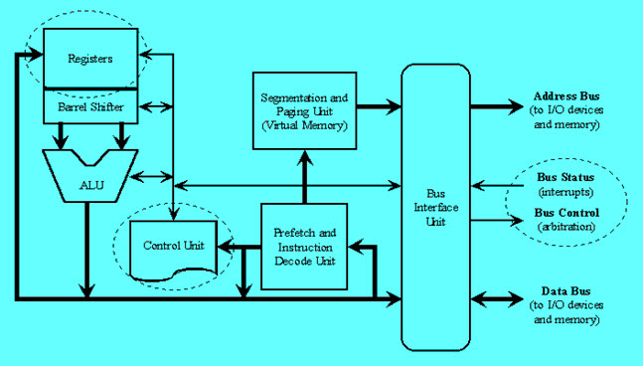
CISC ARCHITECTURE
CISC designs involve very complex architectures, including a large number of instructions and addressing modes, whereas RISC designs involve simplified instruction set and adapt it to the real requirements of user programs.
CISC and RISC Design

Slide 17
CISC ARCHITECTURE
Advantages of CISC architecture
Microprogramming is easy assembly language to implement, and less expensive than hard wiring a control unit.
The ease of microcoding new instructions allowed designers to make CISC machines upwardly compatible:
As each instruction became more accomplished, fewer instructions could be used to implement a given task.
Disadvantages of CISC architecture
The performance of the machine slows down due to the amount of clock time taken by different instructions will be dissimilar
Only 20% of the existing instructions is used in a typical programming event, even though there are various specialized instructions in reality which are not even used frequently.
The conditional codes are set by the CISC instructions as a side effect of each instruction which takes time for this setting – and, as the subsequent instruction changes the condition code bits – so, the compiler has to examine the condition code bits before this happens.

Slide 18
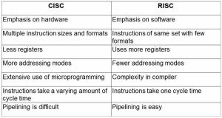
COMPARISON ON CISC AND RISC
ARCHITECTURE

Slide 19
COMPARISON ON CISC AND RISC
ARCHITECTURE
RISC Vs CISC

Slide 20
COMPARISON ON CISC AND RISC
ARCHITECTURE
Memory Unit
RISC has no memory unit and uses a separate hardware to implement instructions. CISC has a memory unit to implement complex instructions
Program
RISC has a hard-wired unit of programming. CISC has a microprogramming unit
Design
RISC is a complex compiler design. CISC is an easy compiler design
Calculations
RISC calculations are faster and more precise. CISC calculations are slow and precise
Decoding
RISC decoding of instructions is simple. CISC decoding of instructions is complex
Time
Execution time is very less in RISC. Execution time is very high in CISC.

Slide 21
COMPARISON ON CISC AND RISC
ARCHITECTURE
External memory
RISC does not require external memory for calculations. CISC requires external memory for calculations.
Pipelining
RISC Pipelining does function correctly. CISC Pipelining does not function correctly.
Stalling
RISC stalling is mostly reduced in processors. CISC processors often stall.
Code Expansion
Code expansion can be a problem in RISC whereas, in CISC, Code expansion is not a problem.
Disc space
Space is saved in RISC whereas in CISC space is wasted. The best examples of CISC instruction set architecture include VAX, PDP-11, Motorola 68k,And your desktop PCs on Intel’s x86 architecture, whereas the best examples of RISC architecture include DEC Alpha, ARC, AMD 29k, Atmel AVR, Intel i860, Blackfin, i960, Motorola 88000, MIPS, PA-RISC, Power, SPARC, SuperH, and ARM too.

